Slide 1

DATABASE
ANALYSIS OF
VULNERABILITIES
‘’For Every Lock, There Is Someone Out There Trying To Pick It Or Break In’’

Slide 2




team
Saputhanthri N.D – IT18015140
W.B.G.R.K. Madhuthisara – IT20661892
K.N. Samaraweera - IT20661588
H.D.R .S Devinda- IT20647032
Bachelor of Science Hons. In Information Technology (Specialization in Cyber Security)
Department of Information Systems Engineering
Sri Lanka Institute of Information Technology Sri Lanka
Bachelor of Science Hons. In Information Technology (Specialization in Cyber Security)
Department of Information Systems Engineering
Sri Lanka Institute of Information Technology Sri Lanka
Bachelor of Science Hons. In Information Technology (Specialization in Cyber Security)
Department of Information Systems Engineering
Sri Lanka Institute of Information Technology Sri Lanka
Bachelor of Science Hons. In Information Technology (Specialization in Cyber Security)
Department of Information Systems Engineering
Sri Lanka Institute of Information Technology Sri Lanka

Slide 3

Anticipated Learning Outcomes
Understand security concerns of different scales related to databases.
Understand the importance of protecting databases which is hardly an easy task.
Explore database vulnerabilities and Mitigating techniques.
Saputhanthri N.D – IT18015140

Slide 4

Denial-of-Service Attack
A DoS attack is one where the attacker does not manage to compromise service, gain elevated privileges or steal information.
Instead, that attacker brings the service down or cripples it to a point that legitimate users of the service cannot use it effectively.
Different classes of denial DoS attacks:
Abuse of Functions
Complex Queries
Bugs and Defects
Application Usage
Saputhanthri N.D – IT18015140

Slide 5

SQl Injection & DATA Breaches
SQL injection is a technique to maliciously exploit applications that use client-supplied data in SQL statements. Attackers trick the SQL engine into executing unintended commands by supplying specially crafted string input, thereby gaining unauthorized access to a database in order to view or manipulate restricted data.
Types of SQL Attacks:
First order attack
Second order attack
Lateral injection
The sensitive data should get managed in a way in which the data doesn’t fall into an attacker’s hand. If this sensitive data is not managed properly and not secured this data will get exposed to threats like data breaches.
Saputhanthri N.D – IT18015140

Slide 6

DATABASE
HOW EACH
VULNERABILITIES WORKS
W.B.G.R.K. Madhuthisara : IT20661892

Slide 7
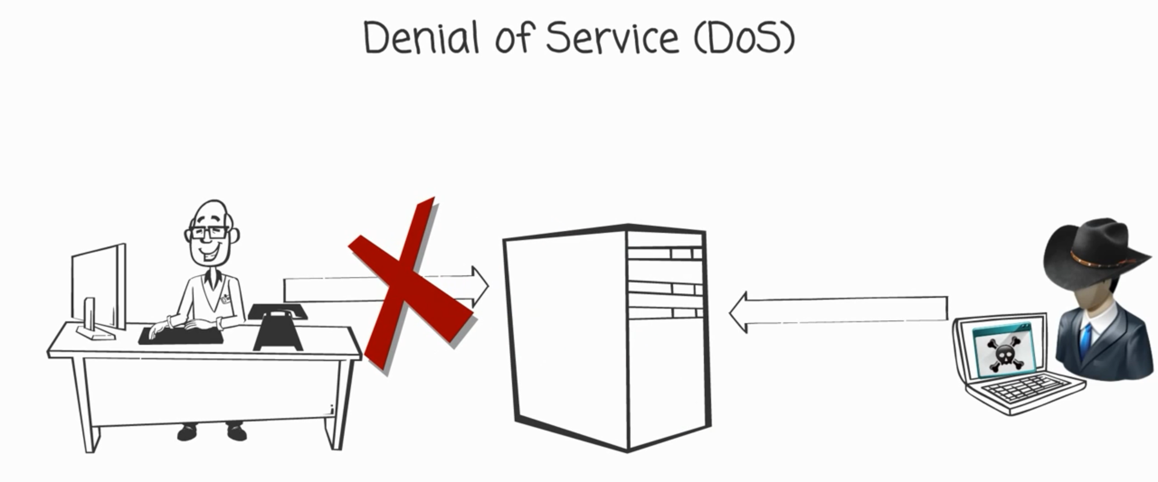
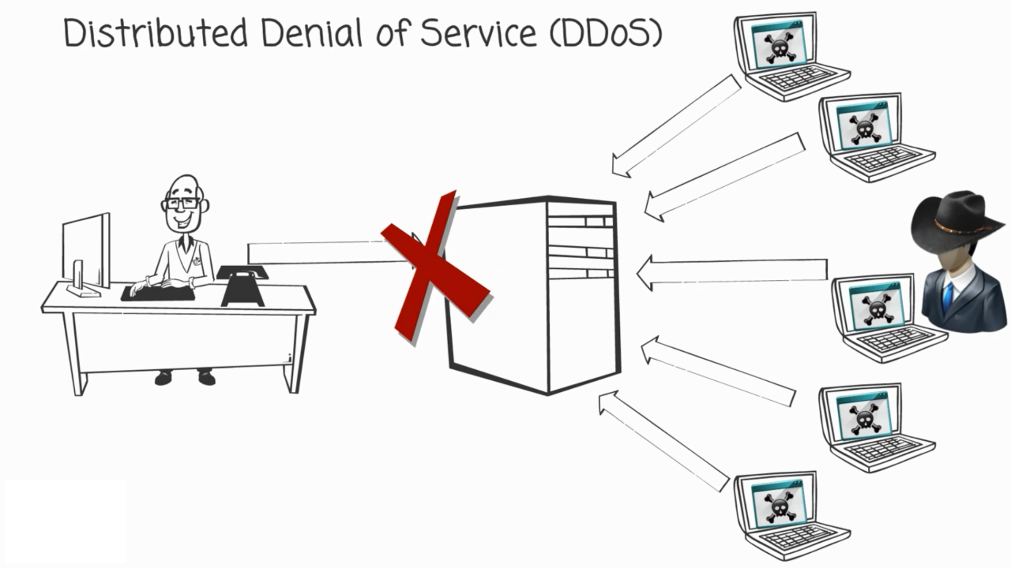
1.Denial-of-Service Attack
DOS is a vey powerful attack in which the hacker make system data unavailable to someone who needs it.
The only difference between DOS & D-DOS is their scale. Single DoS attacks come from one source, while DDoS (distributed) attacks come from multiple locations.
W.B.G.R.K. Madhuthisara : IT20661892

Slide 8
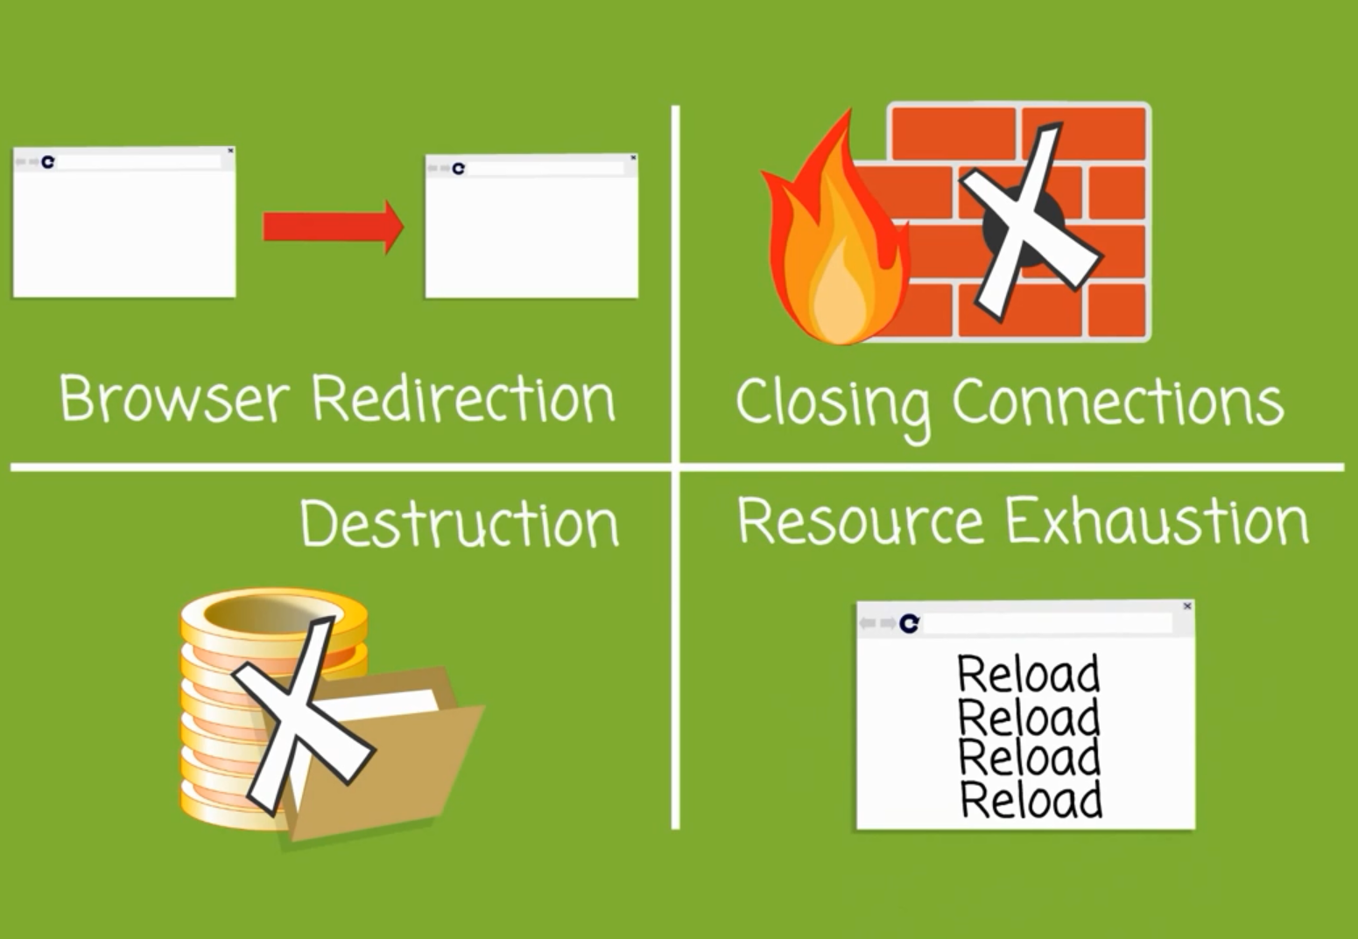
There're many ways to do a DOS attack
Browser Redirection
Closing Connections
Destruction of data
Resource Exhaustion
W.B.G.R.K. Madhuthisara : IT20661892

Slide 9
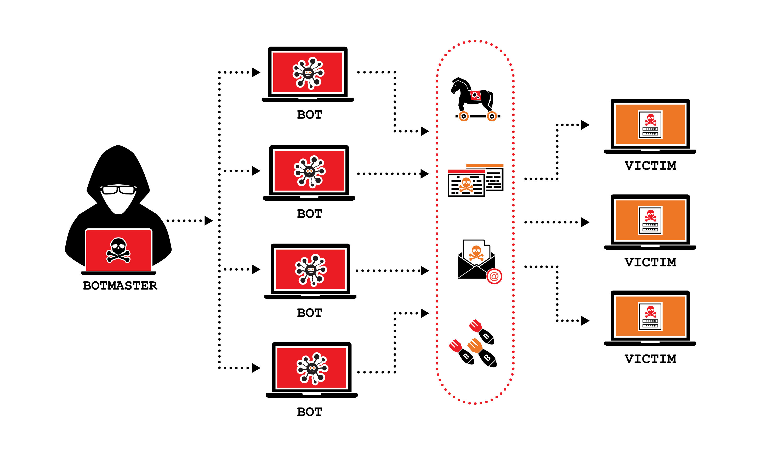
DDoS attacks today originate from a hacker-controlled botnet of vulnerable IoT devices like
internet connected
Security Cameras
Household Appliances
Smart TVs
Home Lighting Systems
And Even Refrigerators
W.B.G.R.K. Madhuthisara : IT20661892

Slide 10
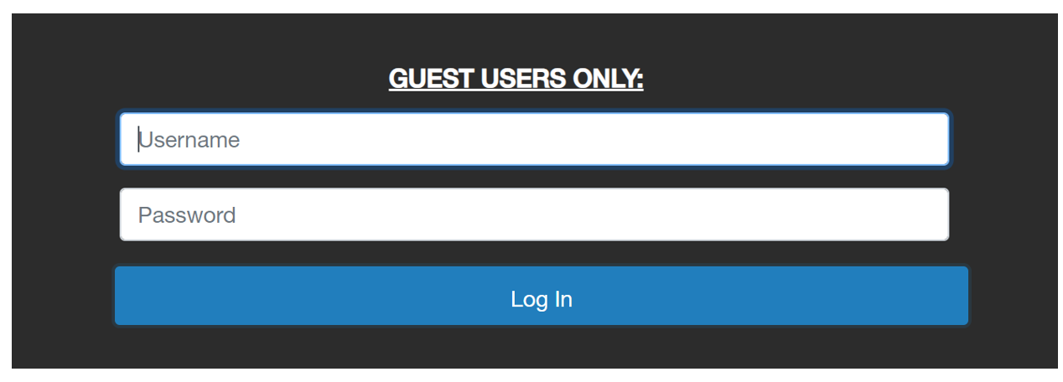
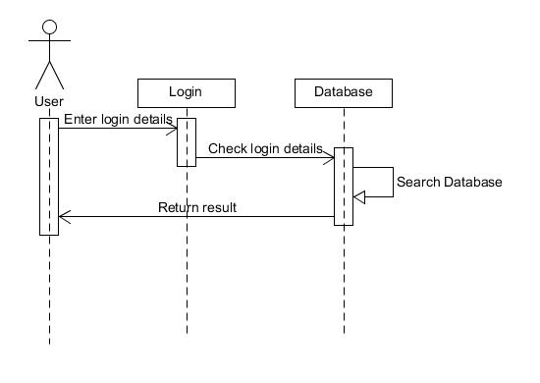
2.SQL Injection Attack
To make an SQL Injection attack, an attacker must first find vulnerable user inputs within the web page or web application.
The attacker can create input content Such as malicious payload and is the key part of the attack.
After the attacker sends this content, malicious SQL commands are executed in the database.
W.B.G.R.K. Madhuthisara : IT20661892

Slide 11
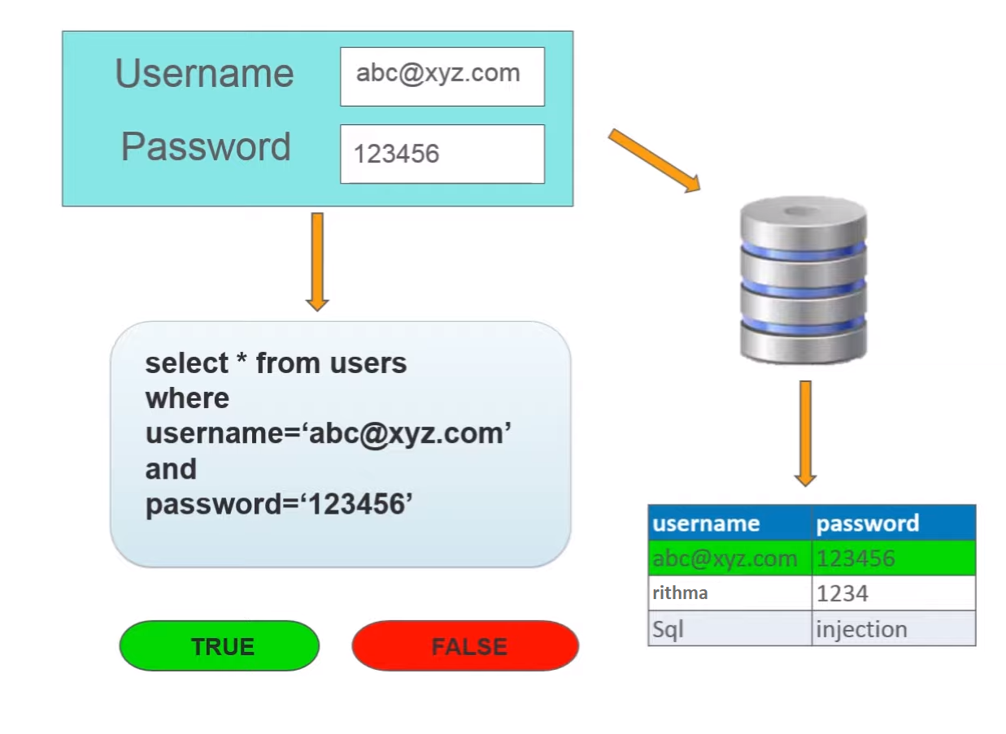
In many web applications and websites store all the data in SQL databases
Attacker uses user input directly in an SQL query on web page or web application that has an SQL Injection vulnerability
The query will check the input data with data on in the tables & return true or false.
W.B.G.R.K. Madhuthisara : IT20661892

Slide 12
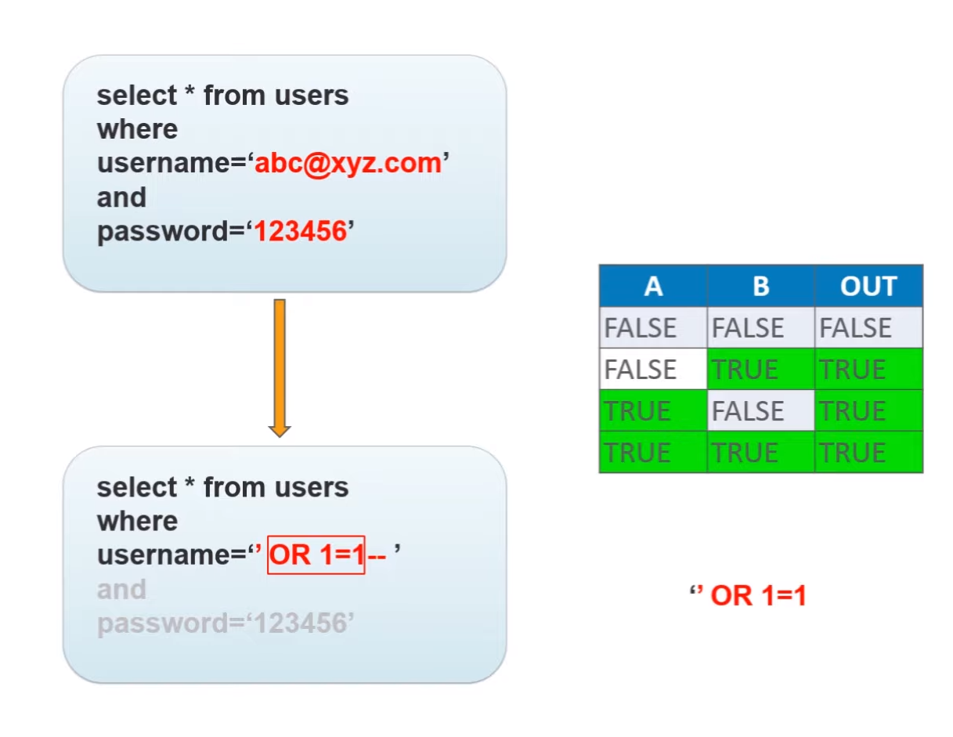
To do this attack, attackers uses Or logic gate.
If one input is true the SQL query output is always true.
"" OR 1=1—
W.B.G.R.K. Madhuthisara : IT20661892

Slide 13

DATABASE
HOW TO MITIGATE EACH
VULNERABILITIES
K.N. Samaraweera - IT20661588

Slide 14
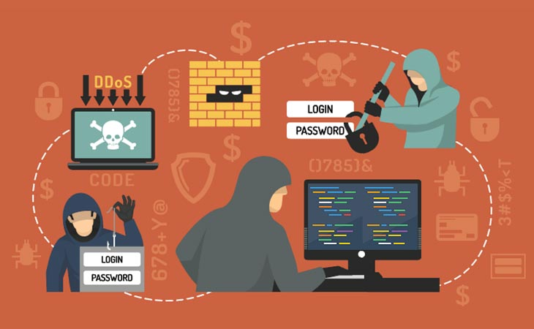
HOW TO MITIGATE SQL INJECTION ATTACKS
Using prepared statements
Using stored procedure's
escape all user supplied input
K.N. Samaraweera - IT20661588

Slide 15

HOW TO MITIGATE DOS ATTACKS
Have a dos plan
Protect networks
Define a specific team
Update everything regularly
K.N. Samaraweera - IT20661588

Slide 16

suggested
Available and
countermeasures
H.D.R .S Devinda- IT20647032

Slide 17

1.COUNTERMEASURES OF DOS ATTACK
Test and apply security patches
Use an IPS to monitor regularly for DoS attacks
Minimize IP spoofing
Block all unwanted ICMP traffic inbound to your network
Disable all unneeded TCP/UDP small services
H.D.R .S Devinda- IT20647032

Slide 18
1.COUNTERMEASURES OF SQL INJECTION ATTACK
Defensive coding practices
Input type checking
Encoding on input
Positive pattern matching
Identification of all input sources
Sanitize the inputs.
Escape the inputs.
Limit database permissions and segregate users.
Use stored procedures for database access.
Configure error reporting.
Using tools.
H.D.R .S Devinda- IT20647032

Slide 19

Thank you
BSc Honors In Information Technology Specializing In Cyber Security
IE2042- Database Management Systems For Security
Year 2 Semester 1 - August 2021
Group Assignment Analysis Of Database Vulnerabilities
Group_15

